Slide 1
PrintNet T Triple Suite
Advanced Training

Slide 2





Agenda
Global Variables
ParamInput module
Orphan/Widow feature (paragraphs and tables)
Variable page selection
Error Recovery

Slide 3

1. Global Variables

Slide 4
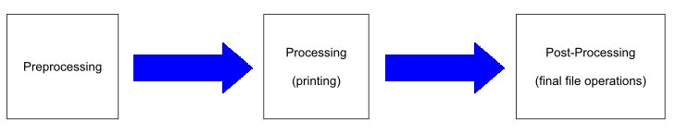
Global Variables
  Modification and storage of a variable.
  Placed in preprocessed objects.
  It has to be placed/modified in a FlowArea flowing from page to page.
Notes:
Using global variables you can modify and remember a variable within one page, one record or whole job.
If you want to store a value in a Global Variable from record to record, then it has to be placed in objects which are preprocessed .
It has to be placed/modified in a FlowArea flowing from page to page or in Next page tab in Layout.

Slide 5

Global Variables
4 possible application methods
  Using Auto add for calculating Global variable
  Writing to Global variable from a variable placed in a Flow
  Writing to Global variable from a variable placed on Next Page
  Using Global variables in tables with fixed height

Slide 6
Global Variables
  Auto add
    Global Variable should be cleared. (See option Auto clear).
    “Flowing to next page” must be checked on the flow where the cumulated variable is used.
Notes:
If you want to cumulate the values, you can use Auto add feature
It is important to set the occasion on which the content of the Global Variable should be cleared. (See option Auto clear)
“Flowing to next page” must be checked on the flow where the cumulated variable is used (the sum of this variable is saved to the global variable).

Slide 7
Global Variables
  WriteToGlobal variable before showing GlobalVar used
    “Flowing to next page” must be checked on the flow where the cumulated variable is used.
    Variable which writes to Global variable must be placed in Layout tree BEFORE Global Variable.
Notes:
It is important to use (process) WriteToGlobal variable before showing GlobalVar.
We must check Flowing to Next Page in flow containing the variable which writes to the Global variable, so that the variable pre-processed
Variable which writes to Global variable must be placed in Layout tree BEFORE Global Variable.

Slide 8
Global Variables
  Global variable entered in the Next page tab
    unknown content of the global variable until the first page is preprocessed.
    very useful for remembering values from page to page.
Notes:
Global variable is entered in the Next page tab and it is modified after the whole page has been processed.
In this case we don’t know the content of the global variable until the first page is preprocessed.
This can be useful, if you want to remember values from page to page.

Slide 9
Global Variables
  Using Global variables in tables
    Table without fixed height.
    Table with fixed height
      Cells not preprocessed
      Cells not preprocessed, “Always process” option overrides
Notes:
Using Global variables in tables
Table without fixed height (default settings) - Cells are always preprocessed. Global variables are displayed correctly. Slow.
Table with fixed height cells - Cells are NOT preprocessed, so global variable is cleared on each page/record (if it overflows). Fast.
Table with fixed height cells - only cells with option „Always process“ checked are preprocessed, so global variables are displayed correctly.
Other cells are not preprocessed, so the processing of this table is faster than 1, slower than 2.

Slide 10
Global Variables
Practical example:
See GVarPDFreader.wfd
Listing of all PDF pages
Global variable incrementing until equal to total PDF pages

Slide 11
2. Orphan/Widow

Slide 12
Orphan/Widow
  Flow break after
  Keep lines together
  Keep with next paragraph
  Do not wrap
  Orphan
  Widow
Notes:
Flow break after...breaks after FlowArea or Page
Keep lines together ...If yes, the whole paragraph will be always together, it never happens that only part flows to another page.
Keep with next paragraph - If yes, the paragraph must always be displayed on the same page as the following paragraph.
Do not wrap - If no, text will be wrapped once it reaches the end-of-line limit
Orphan -minimal amount of lines remaining in the next flow
Widow - amount of lines remaining in the original flow

Slide 13
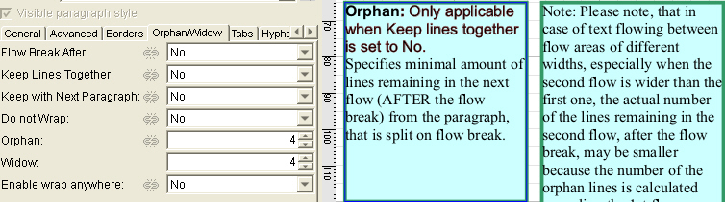
Orphan/Widow
Example:
  Orphan/Widow functionality
Notes:
Orphan – number of lines remaining in the second flow area (4).
Widow – number of lines remaining in the first flow area (4).

Slide 14


Orphan/Widow
Example:
  Break after
    No
    Column
    FlowArea
    Page
Notes:
Break after:
No – nothing happens
Column – the following paragraph displayed in the following column
FlowArea – the following paragraph displayed in the following FlowArea
Page - the following paragraph displayed on the following following page
Screenshots:
The first – Break After set to “NO”
The second – Break After set to “FlowArea.”

Slide 15
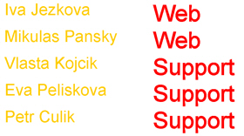


Orphan/Widow
Example:
  Orphan/Widow usage in tables (rows)
Notes:
Screenshots:
No Break after set in the table
Break after the last member of the team is set (need to create a new bool variable reporting whether this is the last member of the team.

Slide 16
3. Variable Page Selection

Slide 17
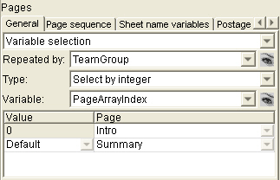
Variable Page Selection
Repeated by
Notes:
Repeated by: Selects an array that will organize pages of each record into subrecords
In this case, the defined page sequence will take place for each team.

Slide 18
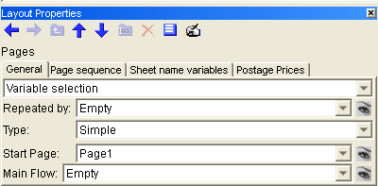
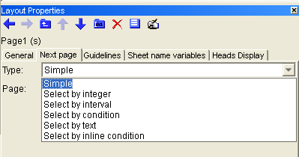
Variable Page Selection
Allows definition of variable page sequence according to a specific criteria:
    - Select by integer
      - Select by interval
      - Select by condition
      - Select by text
      - Select by inline condition
Notes:
See 2_2_VarPageSelection.wfd and varPageSelect.wfd
2_2_VarPageSelection.wfd
Records by: GMC
But we want to make page sequention by Teams and maintain records by GMC. That’s why we have to set
Pages repeated by: TeamGroup, Select by integer
If first member of team is following, Introduction page is shown
If it is not first member, his list of calls is shown until overflowing. Then follows next team member.
If it is the last member of team, End page is shown.

Slide 19

4. Error Recovery

Slide 20
Error Recovery
This feature allows you to print good records only and log bad ones into a file
The log file can be used later to filter the records and pass the bad ones only (or good ones) for reprint.
Notes:
This feature allows you to print good records only and log bad ones into a file
The log file can be used later to filter the records and pass the bad ones only (or good ones) for reprint.

Slide 21
Any questions? Thank You.

